Slide 1
Fraud Transaction Detection Using Machine Learning
BY
ABHIGNA RAGALA
ABHIJEETH RAGALA
NIHITHA VADLAMURI

Slide 2
Contents
Problem Statement
Introduction
Dataset Description
Literature Survey
Implementation
Conclusion
References

Slide 3
Problem Statement
Build a smart system with machine learning to better catch fake transactions in finance.
The goal is to make a model that checks lots of transaction data, finds weird patterns suggesting fraud, and quickly tells apart real and suspicious transactions.
This system should learn about new fraud tricks, reduce mistakes in spotting fake and real transactions, and easily fit into existing financial systems for strong defense against fraud.

Slide 4
INTRODUCTION
In today's world, online transactions are everywhere, but so are sneaky attempts to cheat the system.
Fraud transaction detection is a critical aspect of financial security, involving the use of advanced technologies and analytical techniques to identify and prevent fraudulent activities within financial transactions.
Crooks are always finding new tricks, making it hard for old-fashioned security measures to keep up.
That's where machine learning comes in – it's like a super-smart detective that can learn from patterns and spot shady behavior.

Slide 5
Introduction
Common Types of Fraud:
Credit Card Fraud: Unauthorized use of credit card information.
Identity Theft: Stealing personal information to impersonate someone else.
Account Takeover: Illegally gaining access to someone's account.
Phishing: Tricking individuals into revealing sensitive information.

Slide 6
Dataset Description
Total 31 Columns , Total 2,84,808 Rows
Time
V1 – V28
Amount
Class (0 or 1)
Class is the Target Column where if Class = 0 then the Transaction is Legal else Class = 1 then Transaction is Fraud
PCA is applied on the Dataset

Slide 7
Dataset Description
Total Number of Transactions = 2,84,807
Number of Fraud Transactions = 492
Number of Legal Transactions = 2,84,315
This is very highly unbalanced data so we have to follow under sampling or over sampling

Slide 8
Literature Survey
Paper - 1
Title : Fraud Detection in Mobile Payment Systems using an XGBoost‑based Framework
Authors : Petr Hajek, Mohammad Zoynul Abedin, Uthayasankar Sivarajah
Date of Publish : 14 October 2022
Keywords : Mobile payment, Fraud detection, Machine learning , Imbalanced data,
Publisher : Information Systems Frontiers (2023)
DOI : https://doi.org/10.1007/s10796-022-10346-

Slide 9
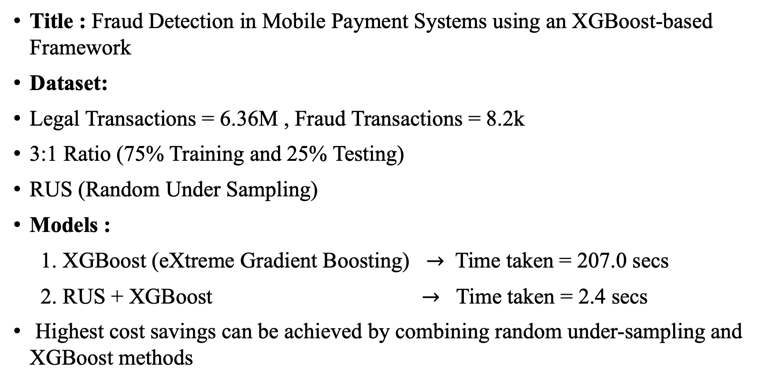
Title : Fraud Detection in Mobile Payment Systems using an XGBoost‑based Framework
Dataset:
Legal Transactions = 6.36M , Fraud Transactions = 8.2k
3:1 Ratio (75% Training and 25% Testing)
RUS (Random Under Sampling)
Models :
1. XGBoost (eXtreme Gradient Boosting) $→$ Time taken = 207.0 secs
2. RUS + XGBoost $→$ Time taken = 2.4 secs
Highest cost savings can be achieved by combining random under-sampling and XGBoost methods

Slide 10
Paper - 2
Title : Fraud detection in capital markets: A novel machine learning approach
Authors : Ziwei Yi, Xinwei Cao, Xujin Pu, Yiding Wu, Zuyan Chen, Ameer Tamoor Khan, Adam Francis, Shuai Li
Date of Publish : 6 June 2023
Keywords : Fraud detection, Listed corporates, Machine learning, ESOA, Egret Swarm Optimization Algorithm
Publisher : Expert Systems With Applications
DOI : https://doi.org/10.1016/j.eswa.2023.120760

Slide 11
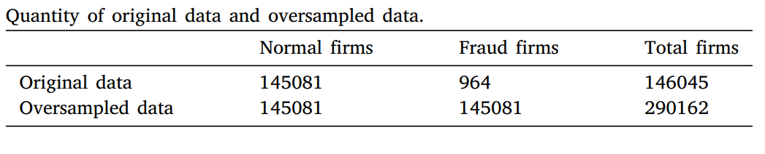
Title : Fraud detection in capital markets: A novel machine learning approach
Dataset : AAER(Accounting and Auditing Enforcement Releases) benchmark dataset collected by the UCB’s Center (University of Berkeley)
42 Different Variables
Using SMOTE(Synthetic Minority Oversampling Technique)
Using ESOA(Egret Swarm Optimization Algorithm)
Accuracy = 96.27%

Slide 12
Paper - 3
Title : Feature-wise attention based boosting ensemble method for fraud detection
Authors : Ruihao Cao, Junli Wang, Mingze Mao, Guanjun Liu, Changjun Jiang
Date of Publish : 31 July 2023
Keywords : Fraud detection, Attention mechanism, Ensemble learning Boosting
Publisher : Engineering Applications of Artificial Intelligence
DOI : https://doi.org/10.1016/j.engappai.2023.106975

Slide 13
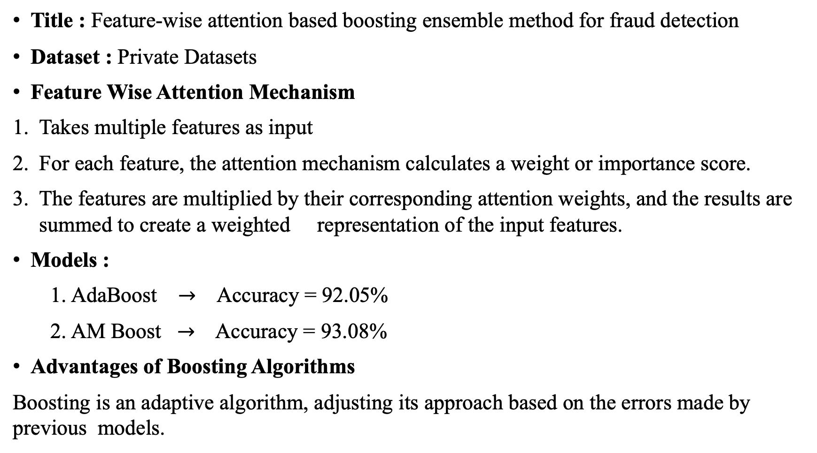
Title : Feature-wise attention based boosting ensemble method for fraud detection
Dataset : Private Datasets
Feature Wise Attention Mechanism
Takes multiple features as input
For each feature, the attention mechanism calculates a weight or importance score.
The features are multiplied by their corresponding attention weights, and the results are summed to create a weighted representation of the input features.
Models :
1. AdaBoost $→$ Accuracy = 92.05%
2. AM Boost $→$ Accuracy = 93.08%
Advantages of Boosting Algorithms
Boosting is an adaptive algorithm, adjusting its approach based on the errors made by previous models.

Slide 14
Implementation
Our Dataset is highly unbalanced , so we have done under sampling
Total Number of Fraud Transactions = 492.
We have done Random Under Sampling.
We have reduced Target Column from 284315 rows to 492*2 = 984 rows
Training : Testing = 80 : 20

Slide 15
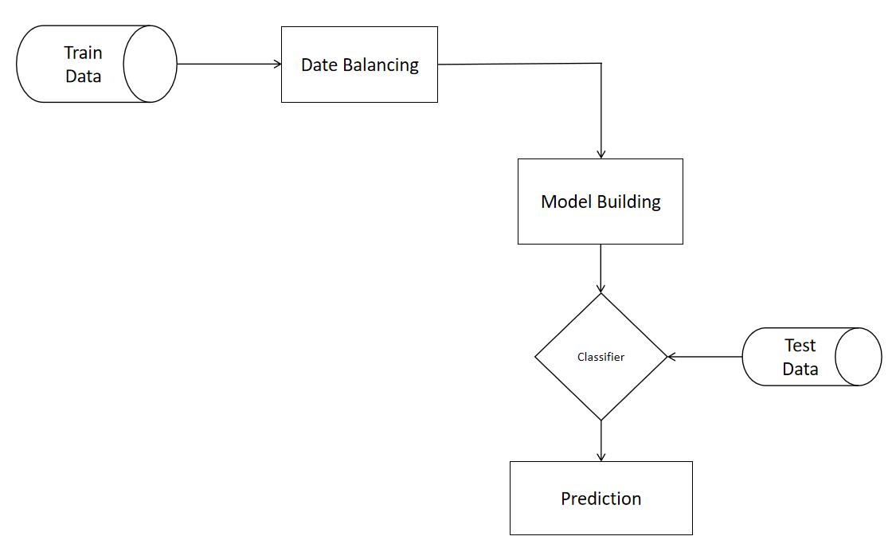
Implementation

Slide 16
Classifiers we used
SVM(Support Vector Machine)
Logistic Regression
Random Forest Classifier
Naïve Bayes (Bernoulli NB)
XG Boost
CAT Boost

Slide 17
Implementation
Based on the F1 scores Random Forest, XG Boost, Naïve Bayes performs better than other models.

Slide 18
Based on the F1 scores we performed Base estimators = [Random Forest, XG Boost, Naïve Bayes]. So Ensemble Classifiers performs very well

Slide 19
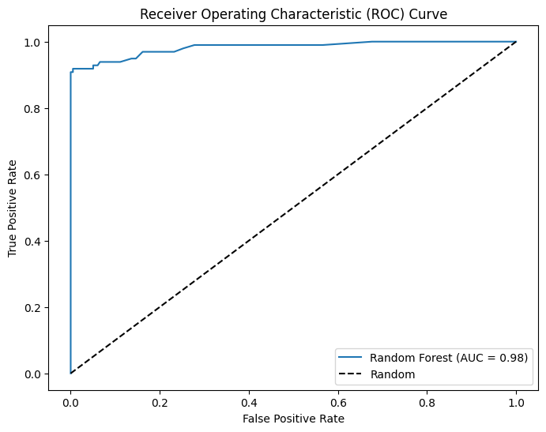
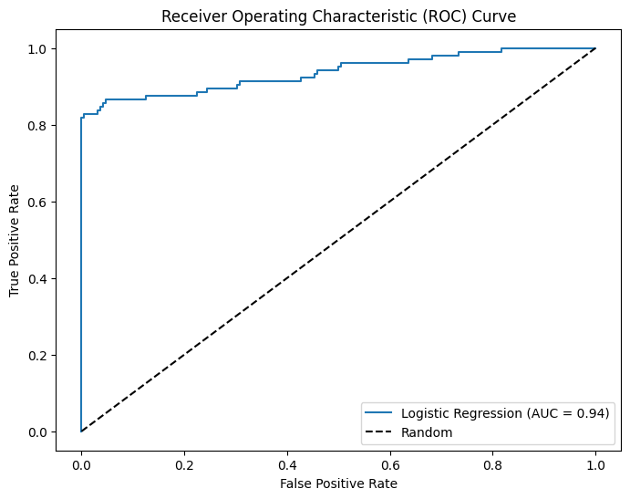
Implementation
ROC Curves

Slide 20
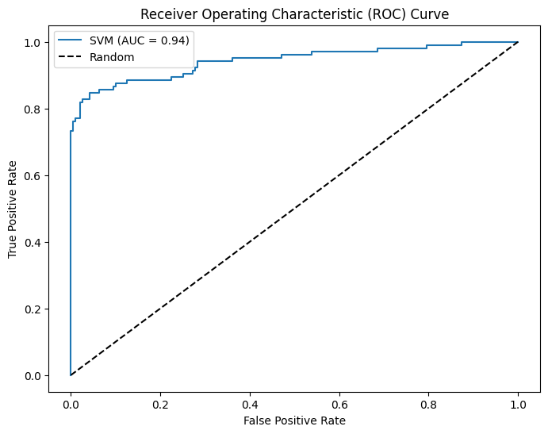
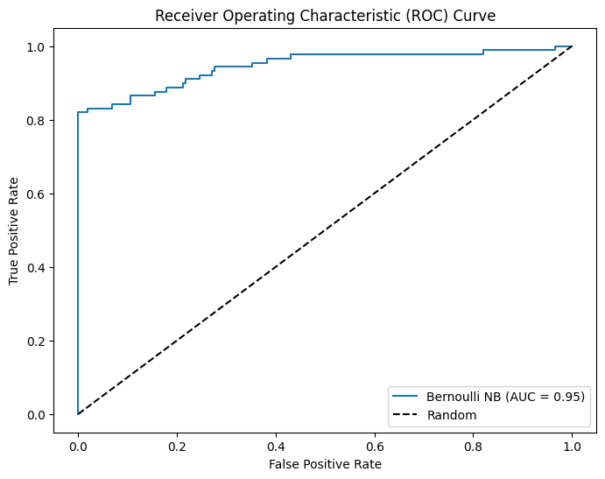
Implementation
ROC Curves

Slide 21
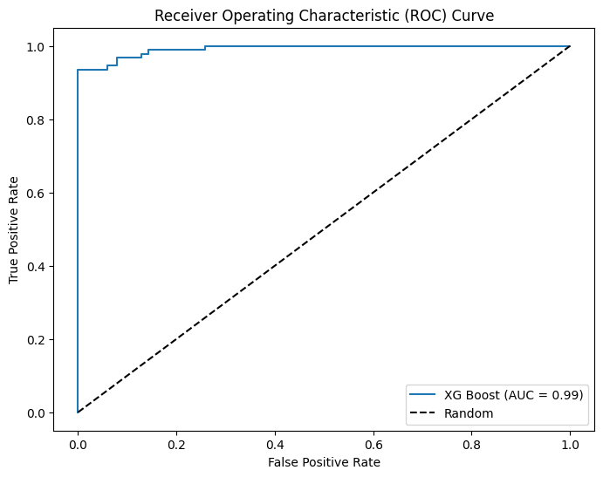

Implementation
ROC Curves

Slide 22
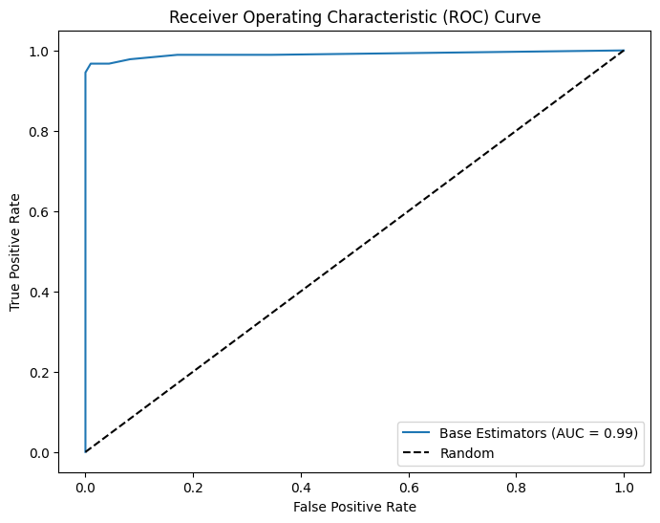
Implementation
ROC Curves

Slide 23
Conclusion
Using machine learning for fraud detection has proven highly effective in improving the security of financial transactions.
These smart algorithms not only identify and prevent fraudulent activities more accurately but also adapt to new tactics, staying ahead of potential threats.
Despite challenges, ongoing advancements make machine learning a crucial tool in safeguarding financial systems and enhancing overall security.

Slide 24
REFERENCES
[1] Hajek, P., Abedin, M.Z. and Sivarajah, U., 2023. Fraud detection in mobile payment systems using an XGBoost-based framework. Information Systems Frontiers, 25(5), pp.1985-2003.
[2] Yi, Z., Cao, X., Pu, X., Wu, Y., Chen, Z., Khan, A.T., Francis, A. and Li, S., 2023. Fraud detection in capital markets: A novel machine learning approach. Expert Systems with Applications, p.120760.
[3] Cao, R., Wang, J., Mao, M., Liu, G. and Jiang, C., 2023. Feature-wise attention based boosting ensemble method for fraud detection. Engineering Applications of Artificial Intelligence, 126, p.106975.
[4] AbdulSattar, K. and Hammad, M., 2020, December. Fraudulent transaction detection in FinTech using machine learning algorithms. In 2020 International Conference on Innovation and Intelligence for Informatics, Computing and Technologies (3ICT) (pp. 1-6). IEEE.

Slide 25
[5] Chung, J. and Lee, K., 2023. Credit Card Fraud Detection: An Improved Strategy for High Recall Using KNN, LDA, and Linear Regression. Sensors, 23(18), p.7788.
[6] Roseline, J.F., Naidu, G.B.S.R., Pandi, V.S., alias Rajasree, S.A. and Mageswari, N., 2022. Autonomous credit card fraud detection using machine learning approach. Computers and Electrical Engineering, 102, p.108132.
[7] Baker, M.R., Mahmood, Z.N. and Shaker, E.H., 2022. Ensemble Learning with Supervised Machine Learning Models to Predict Credit Card Fraud Transactions. Revue d'Intelligence Artificielle, 36(4).

Slide 26
THANK YOU

